Slide 1

Code Without Barriers 2023
Barclays Problem Statement
Beatrice Goh

Slide 2
Contents
Introduction to Problem Statement
About the data
Machine learning models applied
Evaluation of results
Assumptions & considerations
Learning points
Conclusion

Slide 3
Problem Statement
Dataset from UCI Machine Learning Repository
Airfoils generate noise that can be loud and disturbing to the human ear
Understand about these influencing factors through data exploration
Perform machine learning models to predict sound level range
Sound levels are converted into one of 3 possible classes : low, moderate, high

Slide 4



About the data
Inputs affecting noise level
Frequency
Angle of attack
Chord length
Free-stream velocity
Suction side displacement thickness
Records
1,503 instances with no missing values
Relationship between variables are not linear
Skewness observed in the distribution of input factors
Input factors do not follow a normal distribution
No collinearity observed between input factors and with target output class
Output
Record placed into one of 3 classes based on actual sound level output (in decibels)
Low (100 – 113)
Moderate (114 – 127)
High (128 and above)

Slide 5
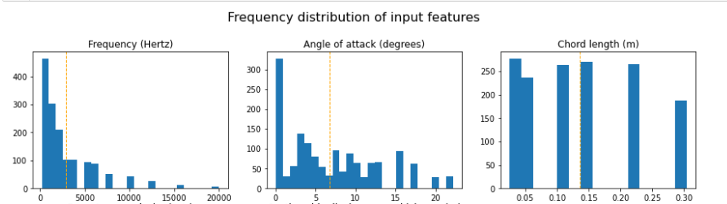
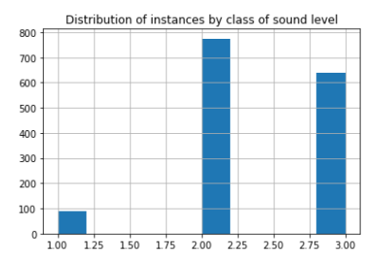
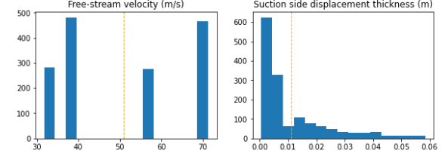
Distribution of observations
Input features
Output sound class
1 – low sound level
2 – moderate sound level
3 – high sound level

Slide 6
Machine learning models applied
Logistic Regression
Decision Tree
K-Nearest Neighbours
Hyper parameter tuning with k-fold cross validation

Slide 7
Evaluation of results
Case 1 (train 80% - test 20%)
Case 2 (train 10% - test 90%)
 | Accuracy
Logistic Regression | 54.5%
Logistic Regression - With 5-fold cross validation | 68.0%
Decision Tree | 81.4%
Decision Tree - With 5-fold cross validation | 79.3%
K-Nearest Neighbours | 81.4%
K-Nearest Neighbours - With 5-fold cross validation | 59.2%
 | Accuracy
Logistic Regression | 60.5%
Logistic Regression - With 5-fold cross validation | 62.2%
Decision Tree | 72.3%
Decision Tree - With 5-fold cross validation | 67.3%
K-Nearest Neighbours | 72.3%
K-Nearest Neighbours - With 5-fold cross validation | 60.4%
Best models were basic decision tree classifier and k-nearest neighbours classifier

Slide 8
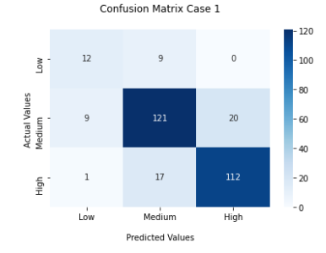
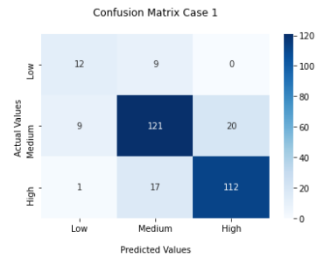
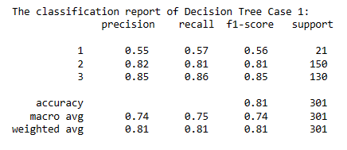
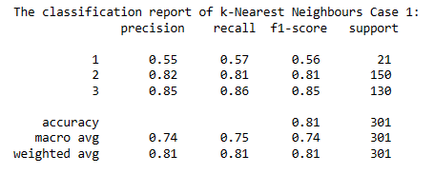
Evaluation of results – Best Models
Decision Tree
k-Nearest Neighbours

Slide 9
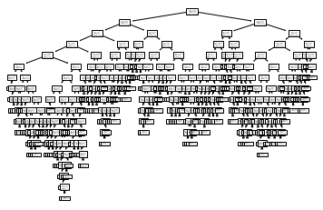
Evaluation of results – Best Models
Both Decision Tree Classifier and k-Nearest Neighbours Classifier did equally well in identifying air foils in moderate and high sound levels, with above 80% F1-score and accuracy.
However, the models did not perform as well in identifying air foils with low sound output, only obtaining 56% F1-score and accuracy.
This is due to the class imbalance, with much fewer records with low sound output.

Slide 10
Observations & Considerations
Observations | Comments / Action taken
Too few records in dataset | Overfitting happened quickly and training models could not converge for some models
During cross validation grid search, some models converge to a local minimum | Some ‘best’ models did not have accuracy score as high as the basic model
Data did not follow normal distribution | Linear Regression was not possible Log transformation of data did not improve the distribution of data
No linear relationship between input features and output | Linear Regression was not possible Classification was a better approach
Target output was converted to 3 classes, ‘low’ sound level class had very few instances | Weights were applied to decision tree and logistic regression Option to apply weights was not available for k-Nearest Neighbours

Slide 11

Learning points & thoughts
This was a very good opportunity to create and perform a machine learning model end-to-end on my own
However, time constraints made it difficult to extend the project further beyond current scope
Project can be further extended to create a UI for users to input parameters of a specific airfoil so as to predict the class of sound level
Explore ways to identify airfoil characteristics based on lower sound output. Even lowest observation is still above acceptable human tolerance (which is typically 80 decibels)
Possibility to use Microsoft Azure solutions for storage of data and perform model training if data set becomes larger

Slide 12

Conclusion
Thanks to Microsoft for organizing this hackathon and the tremendous support that they have extended to the participants
Thanks to sponsors for providing their problem statement and prizes!
It was an invaluable learning opportunity to meet like minded women looking to improve their skills in tech
Thank you!

